Slide 1
Storage Area Network

Slide 2


Storage Area Network Architecture
Clients
LAN
Servers
SAN
Storage

Slide 3
Storage Area Network
Storage units are on the network
  Network is (typically) different from the LAN
    e.g. Fibre-Channel SAN
  Data is accessed raw (in disk blocks) from storage units
    As opposed to file access in NAS
Fibre-Channel SANs were the earliest:
  FC offers high Bandwidth
Alternative SAN technologies available today:
  e.g. IP SAN
SAN and NAS are converging:
  e.g. NAS head with a SAN backend.

Slide 4
Separate Network for Storage
Reasons to use a separate network for Storage:
  Increased Throughput
    improves performance of I/O sensitive applications
  More flexibility
    for change in storage compared to the Direct Attached Storage model
  Reliability
    allows storage devices to be accessed by all servers on the SAN
  Higher Scalability
    in terms of greater numbers of servers and storage units to be interconnected
  Data Mobility / Migration
    is easier
  Data / Storage Management
    is easier (e.g. backup is independent of LAN)

Slide 5
SAN Traffic
Communication between Initiator (a computer and its controller) and target (storage device) uses SCSI
  Recall SCSI commands:
    Types: Non-data, Write, Read, Bidirectional
      E.g. Test Unit Ready, Inquiry, Start/Stop Unit, Request Sense (for error), Read Capacity, Format Unit, Read (5 variants), Write (5 variants)
Command Descriptor:
  Opcode, LUN (3 bits)
  e.g. for Read
    Read (6): 21 bits LBA, 1 byte transfer length
    Read(10): 32 bit LBA, 2 byte transfer length
    Read(12): 32 bit LBA, 4 byte transfer length
    Read (16): 32 bit LBA, 4 byte transfer length (ECC-Compliant data)
    Read(16): 64 bit LBA, 4 byte transfer length

Slide 6
SAN Traffic
So typical SAN Traffic is that of SCSI commands
  The transmission protocol may vary
The earliest SANs used Fibre Channel for transmission
  But iSCSI (Internet SCSI) enables the use of TCP/IP for transmission
Essentially, SCSI commands are carried as payloads (i.e. data) over SAN protocols
  In SCSI -3 Architecture the SCSI command protocol and bus protocol are referred to as the SCSI Parallel Interface (SPI)

Slide 7
NAS vs. SAN
SAN does Block I/O
  NAS does file I/O (i.e. remote file system I/O)
File system in SAN is managed by servers (aka Hosts)
  File system in NAS is managed by NAS head
SAN uses encapsulated SCSI
  NAS uses CIFS/SMB/HTTP over TCP/IP
SAN uses Fibre Channel
  NAS uses TCP/IP Networks

Slide 8
FC SAN Components
Components
  Hosts
    Client / Server computers
  Storage Devices
    Disks, Disk Arrays etc.
  Interfaces
    (Fibre-Channel) Ports for communication
  Hubs, Switches, and Gateways

Slide 9
FC-SAN High Level View
FC Switch A
Host with 2xHBAs
(Initiators)
Storage Array
(target)
FC Switch B

Slide 10
FC Protocol Stack
FC-4 | Upper Layer protocols (PDU): SCSI, IP
FC-3 | Common Services (Multicasting, Striping etc…)
FC-2 | Framing, flow control, zoning
FC-1 | Signaling, encode/decode
FC-0 | Lasers, cables, connectors, data rates
Notes:
FC-4 layer provides mapping rules of fibre channel capabilities to pre-existing protocols.
FC-3: Striping : to transmit one single data unit across multiple links
Multicast : Multicast delivers a single transmission to multiple destination ports.
FC-2 layer servers as a transport mechanism of the fibre channel.
FC-1: This layer defines the transmission protocol that includes serial encoding and decoding rules, special characters used, and error control.
FC-0: This layer defines the physical link between the systems, including the fibre cables, connectors, optical and electrical parameters for a variety of data rates.

Slide 11
SAN Ports: FC Switch Ports
U_Port
  Un-configured and uninitialized
N_Port
  Aka Node Port (to connect end devices)
F_Port
  Switch ports that accept connections from N_Ports operate as fabric ports
L_Port
  Node port used to connect a node to a Fibre Channel loop
E_Port
  Expansion port to connect two SAN switches (allows merging)
EX_Port
  It is a E_Port used for FC routing (Prevent fabrics from merging)
Port Speed:
  2, 4, 8, 16 Gbps

Slide 12
FC-SAN Port Connectivity
FC Switch A
N_Port
F_Port
F_Port
Host with 2xHBAs
(Initiators)
Storage Array
(target)
N_Port
N_Port
FC Switch B
N_Port
F_Port
F_Port
E_Port
E_Port
FC Switch C

Slide 13
Common SAN Topologies: SAN Structure
Point to Point
  Direct connection between HBA port - Storage array port
  e.g. for 8-port storage array, you can have a maximum of 8 directly attached servers talking to that storage array
  Limitation
    No scalability

Slide 14
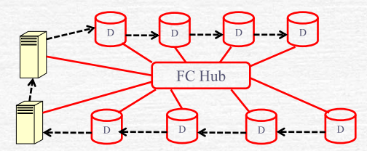
FC -SAN Structure[1]
Structure – Arbitrated Loop (AL)
  Storage devices - through L-ports - are connected to an (FC) AL hub
  Local hosts are also connected to the AL via I/O bus adapters
  Hubs do not allow a high transfer rate (due to sharing) but are cheap.

Slide 15
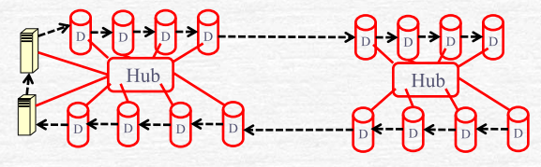
FC SAN Structure[2]
An Arbitrated Loop can span several hubs – referred to as a cascading

Slide 16
FC SAN Structure[3]
An Arbitrated Loop (AL) can be public or private
  A Private loop is closed on itself
  Public loop is connected to a fabric by a switch
    Although a public loop can be connected to more than one switch only one switch can be active at any time
      i.e. additional switch connections are for fault tolerance – i.e. for fail-over only.
  This is realized by a hub connected through a FC-switch to remote hosts
    Switches allow individual connections with high transfer rates but are expensive.

Slide 17
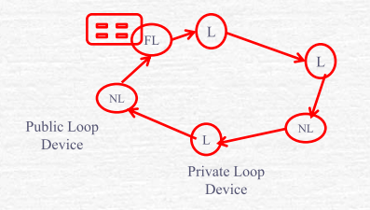
Public Loops
End Devices in a public loop can communicate with end devices in the fabric only if they have NL-ports
A fabric is a collection of connected FC switches that have a common set of services

Slide 18
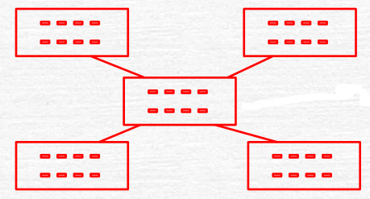
Switched Fabric
Inter-connected FC-Switches

Slide 19
Switched Fabric Topologies[1]
Core Edge Topology
Edge
Core
Edge

Slide 20
Switched Fabric Topologies[2]
Cascade Topology
Ring Topology

Slide 21
Switched Fabric Topologies[3]
Mesh Topology
  Every switch is connected to every other switch

Slide 22
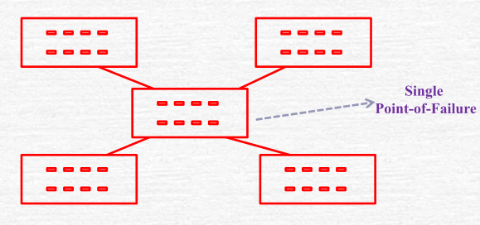
Redundancy and Resiliency[1]
Single Fabric Non-Resilient Design
  Each end-device is connected to one switch (and to one fabric)

Slide 23
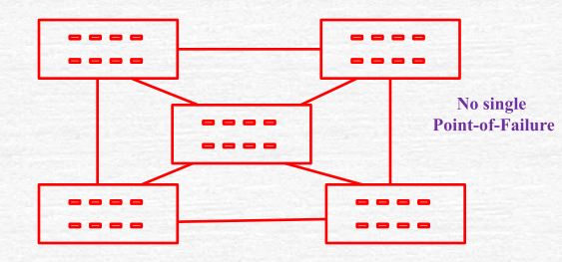
Redundancy and Resiliency[2]
Single Fabric Resilient Design
  Each end-device is connected to one switch (and to one fabric)

Slide 24
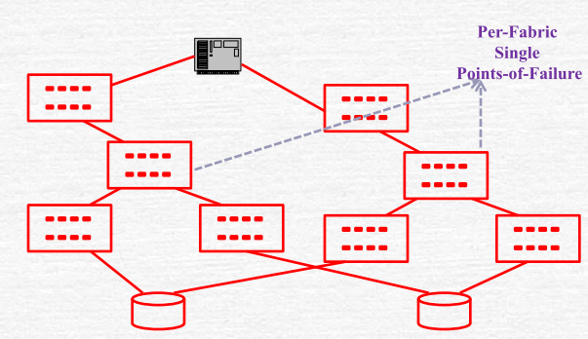
Redundancy and Resiliency[3]
Redundancy and Resiliency:
  Redundant Fabric Non-Resilient Design

Slide 25
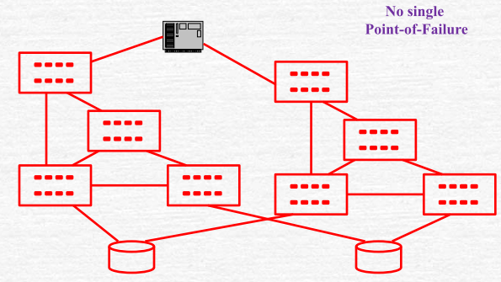
Redundancy and Resiliency
Redundancy and Resiliency:
  Redundant Fabric Resilient Design

Slide 26
SAN Addressing[1]
World Wide Names (WWNs)
  unique World Wide Name per N-port (also referred as WWPNs)
  Devices may have a WWN (independent of the adapters/ports)
  Defined and maintained by IEEE
  64-bit long
  24-bit port addresses may be used locally to reduce overhead.

Slide 27
SAN Addressing[2]
24-bit addressing - in a switched fabric
  Assigned by switch
  At login, each WWN is assigned (mapped) to a 24-bit address by Simple Name Service (SNS)
    SNS is a component of the fabric OS – acts as a registry/database
Address format:
  Domain address (bits 23-16) identifies the switch
    Some addresses are reserved e.g. broadcast
    239 possible address.
  Area address (bits 15-8) identifies a group of F-ports,
  Port address (bits 7-0) identifies a specific N-port
Total addressible ports: 239x256x256

Slide 28
SAN-Addressing[3]
24-bit addressing - in an AL
  Obtained at loop initiation time and re-assigned at login to the switch
  Address Format:
    Fabric loop address (bits 23-8) identifies the loop
      All 0s denotes a private loop i.e., not connected to any fabric
    Port address (bits 7-0) identifies a specific NL-port
      Only 126 addresses are usable (for NL-ports):
      8B/10B encoding is used for signal balancing
      Out of the 256 bit patterns only 134 have neutral running disparity – 7 are reserved for FC protocol usage; 1 for an FL-port (so that the loop can be on the fabric)

Slide 29
SAN Routing
Routing
  Analogous to switching in a LAN
  Goal:
    Keep a single path (bet. Any two ports) alive – no redundant paths or loops
    Additional paths are held in reserve – may be used in case of failures.
  Fabric Shortest Path First (FSPF) protocol –
    Cost: hop count
    Link state protocol
    Link state database (or topology database) kept in switches
    Updated/Initialized when switch is turned on or new ISL comes up or an ISL fails
  Switches use additional logic when hop count is same.
    Round Robin is often used for load sharing

Slide 30
SAN Zoning
Zoning Controls device visibility in a SAN fabric
  Without zoning, initiator will probe and discover all devices on the SAN fabric
Zoning allows fabric segmentation
  Storage (traffic) isolation
    e.g. Scenario: Windows systems claim all visible storage
    Similar to Virtual LANs
      Broadcast isolation: each VLAN is a separate broadcast domain
  Zoning can be done based on WWN and Port

Slide 31
Zoning: Example

Slide 32
SAN Zoning
Hardware Zoning: (1-1, 1-*, *-*)
  Based on ports connected to fabric switches (switches-internal port numbering is used)
  A port may belong to multiple zones
  Advantage:
    Implemented into a routing engine by filtering – i.e. no performance overhead
  Disadvantage:
    Device connections are tied to (physical) ports

Slide 33
SAN Zoning
Software Zoning:
  Based on WWN – managed by the OS in the switch
  Number of members in a zone limited by memory available
  A node may belong to more than one zone.
  More than one sets of zones can be defined in a switch but only one set is active at a time
    Zone sets can be changed without bringing switch down
  Less secure :
    SZ is implemented using SNS
      Device may connect directly to switch without going through SNS
    WWN spoofing
    WWN numbers can be probed

Slide 34
SAN- Frame Filtering
Process of inspecting each frame (i.e. header information) at hardware level for access control
Usually implemented as an ASIC with choice and configuration of filter that can be done at switch initialization/boot time.
  Allows zoning to be implemented with access control performed at wire speed
  Port level Zoning, WWN level Zoning, Device level Zoning, LUN level Zoning, and Protocol level Zoning can be implemented using Frame Filtering

Slide 35
SAN-Trunking
Grouping of ISLs into a trunk i.e. a logical link
  aka Port Channel/ISL trunk
Useful for load sharing in the presence of zoning
  i.e. zoning need not restrict ISL usage
Supports in-order, end-to-end transmission of frames
  Re-ordering done by the switch as required

Slide 36
SAN-Multipathing
Provide multiple paths between a host and a device (LUN).
  Redundancy for improved reliability and/or higher bandwidth for improved availability / performance
Channel subsystem of the kernel in switch OS handles multi-pathing at software level
  Usually Separate device driver is used with following capabilities:
    Enhanced Data Availability
    Automatic path failover and recovery to alternative path
    Dynamic Load balancing
    Path selection policies
Failures handled:
  Device Bus adapters, External SCSI cables, fibre connection cable, host interface adapters
Additional software needed for ensuring that the host sees a single device.

Slide 37
SAN- LUN Masking
LUN Masking
  Which servers (HBAs) can see which LUNs
  Performed on the storage array using WWPN of host’s HBA in FC-SAN
Zoning vs. Masking
  Zoning takes place at SAN switches where as LUN masking takes place on the storage array
  LUN masking provides more detailed security than zoning. How?

Slide 38
FC-SAN Performance Issues
Hop-Count and Latency
Over-subscription
  Device Over-subscription: Number of Computers that need to access a storage device
  ISL Over-subscription: Total bandwidth requirements of all end-to-end connections that are likely over an ISL
Over-subscription will result in
  Congestion – Delayed Deliveries
  Blocking – Failed Deliveries
Fan-out, Fan-in:
  Ratio of server-ports to a single storage port (Fan-out) and Ratio of storage-ports to a single server-port (Fan-in)

Slide 39
iSCSI SAN
iSCSI allows storage resources to be shared over an IP network
iSCSI is a mapping of SCSI protocol over TCP/IP
  Similar to mapping of SCSI over Fibre Channel (FC)
IP
iSCSI Initiators
iSCSI Target

Slide 40
FC-SAN vs. IP-SAN
 | FC SAN | IP-SAN
Protocol Overhead | Low | High
Distance Limit | YES | NO
H/W Cost | High | Low
Network Administration tools availability | NO | YES
Network Latency | Low | High
CPU Use | Low | High
Data Access Protocol | SCSI-III | NFS/CIFS
Access type | Block level (File system is part of Server) | File Level (File system is part of storage)
Interface (Server connector) | HBA | NIC

Slide 41
iSCSI SAN Components
Initiators
  Issue Read/Write data requests to targets
  Request – response mechanism
  Initiators and targets are technically processes that run on the respective devices
Target (disk arrays or servers sharing storage over iSCSI)
IP Network
  Used for transportation of iSCSI PDUs

Slide 42
iSCSI Interfaces
Standard Ethernet NIC with a Software Initiator
  Basic and cheapest interface
  Usually implemented as a kernel based device driver
Ethernet NIC with a TCP Offload Engine and a Software Initiator
  Offloads TCP stack processing from host to NIC
iSCSI Host Bus Adapter
  Reduced impact on host CPU
  Allows boot from SAN
  More Cost
Converged Network Adapter (CNA)
  Also supports for other protocol like FCoE

Slide 43
iSCSI PDU and Encapsulation
iSCSI operates at the session layer of the OSI model
  An application issues an I/O operation to the file system (i.e. OS) which sends to SCSI
  SCSI creates the CDB and sends to iSCSI layer
    The CDB consists of a one byte operation code followed by some command-specific parameters
      SCSI commands- READ BLOCK LIMITS, TEST UNIT READY, READ, WRITE, SEEK etc
  CDBs and associated target LUN data are encapsulated by iSCSI into PDUs at the session layer and passed further down the layers until they hit the wire for transport across the network
There is nothing iSCSI specific about the encapsulation once below the session layer

Slide 44
iSCSI Names
Every device on iSCSI SAN needs a name
  iSCSI names are tied with iSCSI nodes no to the interfaces like HBAs, NIC etc.
  iSCSI names are permanent and globally unique
Naming Conventions
  iSCSI qualified names (IQN)
    233 bytes in length and location independent
    Hierarchical naming
      Type, date, Naming authority, Customizable string
      e.g. iqn.2011-06.com.technicaldeepdive:server:lablinuxdb01
  Other naming conventions
    Extended Unique Identifier (EUI), Network Address Authority (NAA)
Aliases can be used to user friendly names to initiators or target
  Can be used in managements tools not for discovery, login and authentication

Slide 45
Device Discovery
Initiator to target communication requires
  Target IP address
  TCP port
  iSCSI name
Device Discovery Methods
  Manual Device Discovery
    Good for small sized SANs
  Send targets
    Initiator issues the SEND TARGETS command to the network portal on the target . Target responds with a list of available targets
    It assumes prior knowledge of the IP address and the TCP port on the target
    Common for small to medium sized SANs
  Automatic device discovery
    Service Location Protocol (SLP) agent runs on initiator and the target
    Initiator SLP agent issues multicast messages to targets, and service agents on targets responds

Slide 46
iSNS (Internet Storage Name Service)
It is a centralized database containing configuration data about iSCSI SAN
  Good for managing large SAN array
It allows to register and query the information by initiator and target. Provides following services
  Name service
  Partitioning of the iSCSI SAN into discovery domains
  Login Services
  Sate change notifications
  Mapping FC to iSCSI devices
Similar to FC-SAN’s SNS service

Slide 47
Discovery Domains
Used to partitioning iSCSI SAN
  Devices can see and communicate only with other devices in the same DD
Discovery domains are form of security by obscurity
  DD have nothing to physically stop a misbehaving initiator from breaking the rules

Slide 48
iFCP: Mapping of FCP on TCP/IP
Used to connect two IP-SANs
  It is a gateway protocol that connects Fibre Channel devices via a TCP/IP network
  Does mapping of FC-FCP on TCP/IP

Slide 49
FCIP: Connects two FC-SAN by TCP/IP
FCIP is a tunneling protocol

Slide 50
SAN Protocol Taxonomy
Applications
Operating Systems
SCSI Protocol
iSCSI
FCP
FCP
FCP
SCSI
iFCP
FCIP
FC-3
FC-2
TCP
TCP
TCP
Transport and
Fabric Services
IP
IP
IP
Notes:
FCP is realized completely by Fibre Channel Protocols
FCIP creates a point to Point connection between two FC-SANs, with all FC frames being packetized in TCP/IP packets
iFCP is an expansion of FCIP, along with tunneling FC frames it also realizes fabric services such as routing, name server and zoning over TCP/IP
iSCSI is based upon TCP/IP without any reference to Fibre channel

Slide 51
Data Center Network Technologies
Ethernet
  Lossy network due to congestion
  Packet or frame losses needs to be handled by higher layers (e.g. TCP)
  Earlier latency was an issue but not NOW… (e.g. 10Gbps, 40Gbps, and 100Gbps Ethernet)
  Shared media (e.g. Bus topology)
Fibre Channel
  High speed and low latency network
  Exclusively used for storage traffic (e.g. SCSI traffic)
  Operates link layer signaling (communicates buffer credits and status) to avoid packet losses
  Uses Point to Point topology

Slide 52
FC vs. Ethernet
FC is less versatile and scalable as compared to Ethernet
  FC is good for channel technology like SCSI rather network technology
  Channel technology focus on high performance and low overhead interconnects
  Where as network technology (e.g. Ethernet) needs to be scalable and more versatile

Slide 53
Storage Network Requirements
Reliable and efficient transportation of SCSI commands between targets and initiators
SCSI was not designed to deal well with delays, congestion, or transmission errors
FC suits well at transporting SCSI traffic becoz
  Simple topologies (e.g. Arbitrated Loop)
  Good bandwidth
  Low latency
  Lossless
  Deterministic Performance

Slide 54
Enhanced Ethernet: Lossless Ethernet
IEEE task group responsible for it
  Data Center Bridging (DCB) Task Group (802.1)
    Also called Converged Enhanced Ethernet (CEE)
  Objectives
    To transport IP LAN traffic
    FC storage traffic
    Infiband high performance computing traffic (2.5 Gbps)
  Lossless Ethernet
    Enabling PAUSE function (IEEE 802.3)
      Stopping all traffic on a port when a full queue condition is achieved
      PAUSE should be issued only for lossless traffic requirement not for all traffic
      Priority Flow Control (IEEE 802.1Qbb) can halt traffic according to the priority Tag
      Administrators use the eight lanes defined in IEEE 802.1p to create virtual lossless lanes for traffic classes like storage and lossy lanes for other classes

Slide 55
Lossless Ethernet Cont…
Bandwidth sharing between lossless and lossy traffic
  Enhanced Transmission Selection (IEEE 802.1Qaz) allows to share the same link for both types of traffic
  Data Center Bridging Exchange Protocol (DCBX) is responsible for the configuration of link parameters for DCB functions
    Determines which device support the enhanced functionalities (create DCB cloud for FCoE traffic)
    It is a standard-based extension of the Link Layer Discovery Protocol (LLDP)

Slide 56
FCoE Encapsulation
Fibre Channel over Ethernet
  FC frames are encapsulated within layer 2 Ethernet frames and transported over an IEEE 802.3 network
FCoE Encapsulation
  FC frame length is 2148 Bytes
  Standard Ethernet frame size is 1518 Bytes
  How to fit FC frame in Ethernet frame?
    Fragment FC frames
      Results in latency and lower performance
    Use larger Ethernet frames
      e.g. Jumbo frames of size 9 KB

Slide 57
FCoE Encapsulation
FCoE encapsulation process leaves the FC frame intact
  Zoning, WWPNs, and SSN are still applicable
FC frames are not encapsulated within IP packets
FC networks are large, flat, layer 2 and non-routable networks
  It is in contrast to iSCSI …?
FCoE
FC
SCSI

Slide 58
FCoE in Real World
An FCoE switch connects to the LAN and the SAN
  Having CEE (Converged Enhanced Ethernet) and FC both ports
FCoE deployment in industry
  As part of prepackaged converged computing network and storage package
  At the access layer (first hop between host and access layer switches such as Top of Rack)
Fibre connection
to FC SAN
FCoE Switch
Direct Access Copper
From CNA to
FCoE switch
Blade Servers
With CNAs

Slide 59
Cabling Options
For Gigabit Ethernet
  Copper (1000 Base-T with RJ-45 connectors)
    Dominating the market as compared to optical
  Optical (same as used in FC)
For 10 Gigabit Ethernet
  Copper (Twinax)
    Based on SFF-8431 standard and SFP+ interface for a copper connection
    Limited for short distances (e.g. server to TOR connections)
      Widely deployed
    Standard multimode optical cabling can be used for longer distances (e.g. rack to core connections)
      Not much deployed

Slide 60
Remote Direct memory Access (RDMA) [1]
Communication between applications (traditional way)
  Incoming data is accepted by NIC card
  OS kernel process it and deliver to app
  Multiple level buffering
  Costs CPU power and loading system bus
  Increase in latency and reduce throughput

Slide 61
Remote Direct memory Access (RDMA) [2]
Virtual Interface Architecture
  Allows data exchange between apps and network card by bypassing OS (i.e. no CPU intervention)
  How to do…?
    Two communicating apps set-up a connection aka Virtual Interface
    A VI is a common memory area defined on both computers
    Using this memory, app and network card on a machine can exchange data

Slide 62
Remote Direct memory Access (RDMA) [3]
Sender application
  fills the memory area with data
  then app announces by means of the send queue of the VI hardware
  the VI hardware reads the data directly from the common memory area and transmits to the VI hardware of the second computer
  It does not inform to the app until all data is available in the common memory area
  Point to point communication is allowed
  E.g. VI capable FC-HBAs, NICs
  VI communications allows RDMA

